Slide 1








/
I
E R R A F O R M
U
Najoe

Slide 2

$WHOAMI
Ex Razer, Ex BASF, DevOps & Cloud Consultant
WordPress Enthusiast
Founder of Kontraku
Author of Teratak Repo

Slide 3

AEIOU in Transformation
Terraform Mechanics
Transforms ! ! !
Q & A
I TERRAFORM U
TOPIC
Contact

Slide 4

AEIOU IN TRANSFORMATION
MAIN ATTRIBUTES
PROVISIONING
DEPLOYMENT
CONFIGURATION
ORCHESTRATION

Slide 5
AEIOU IN TRANSFORMATION
Activity | Activity Description
Prep & Setup | Setup Server, Network, Database
Maintenance | Update / Maintenance

Slide 6

AEIOU IN TRANSFORMATION
Effort
Activity | Activity Description
Prep & Setup | Setup Server, Network, Database
Maintenance | Update / Maintenance

Slide 7
AEIOU IN TRANSFORMATION
Time
Effort
Activity | Activity Description
Prep & Setup | Setup Server, Network, Database
Maintenance | Update / Maintenance

Slide 8

AEIOU IN TRANSFORMATION
Which previously done by Server Admin or Sys Admin.

Slide 9

AEIOU IN TRANSFORMATION
Which create a loophole :
Human error
High human resources (human capital)
High effort and time

Slide 10

AEIOU IN TRANSFORMATION
With modern concept of administration.
A DevOps lifecycle is introduced.
The sole purpose are to automate all task
end to end and repack the environment
and applications so that software
lifecycle are in seemless move.

Slide 11
TERRAFORM & MECHANICS
Terraform. Is an IaaC tool that allow you to automate or define & manage your infrastructure either in a platform base or services that run on top of the platform or on-premise.
Note: The Platform here is refer as Cloud Provider / Server Provider.

Slide 12
TERRAFORM & MECHANICS
This tools is human readable to configure file, versioning, reuse and share. The consistent workflow to provision and manage is what makes it can go through software lifecyle smooth. It is OpenSource.

Slide 13
TERRAFORM & MECHANICS
Workflow. There are 3 stages :
Write: A step to define your desired resources either to manage or build, which may be across multiple cloud providers and services.
Plan: Terraform creates an execution plan describing the infrastructure it will create, update, or destroy based on the existing infrastructure and your configuration.
Apply: On approval, Terraform performs the proposed operations in the correct order, respecting any resource dependencies.

Slide 14
TERRAFORM & MECHANICS
Method to write
Method | Description | Example
Declarative Method | Declare and get result | "Hey i want to 1 clone server".You will get 1 clone server
Procedural/Imperative Method | A step by step according toinstructions | 1. Create a clone server 2. Assign Firewall 3. Assign Groups 4. Destroy the old one

Slide 15
TERRAFORM & MECHANICS
Similarities and differentiation on Other tools
Other IaaC (Ansible, Chef, Puppets) | Terraform
Provisioning, Configuration Management, Manage Infrastructure | Provisioning, Configuration Management, Manage Infrastructure
Mainly a configuration tools- Configure Infra- Configuration management for deploying and apps- configure to install, and update softeware/dependencies | Mainly infrastructure provisioning tools- Deploy and configure env, software, and app.
Mature | Dynamically change
Stagnant | More Advanced Orchestration
Good for config management | Good for Orchestration

Slide 16
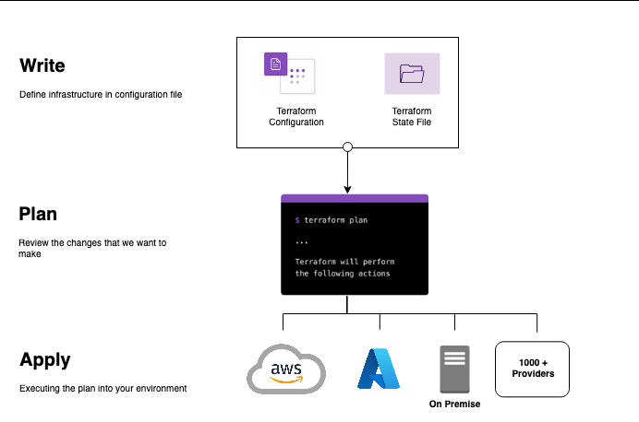
TRANSFORM !!!

Slide 17
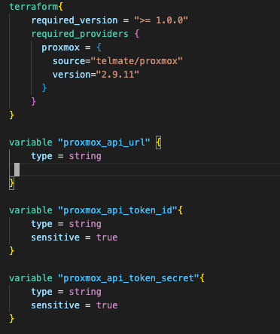
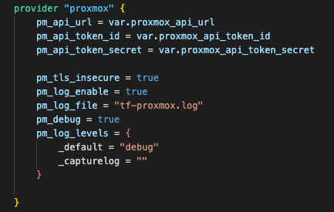
TRANSFORM !!!
main.tf

Slide 18
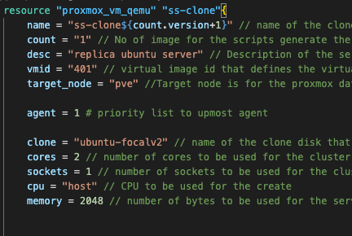
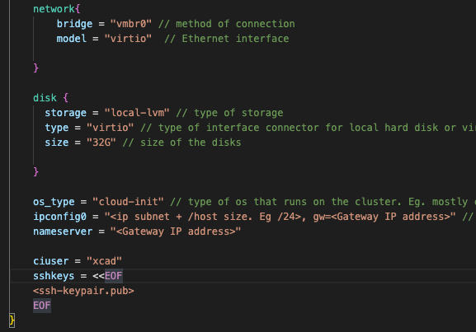
TRANSFORM !!!
ssclone.tf

Slide 19
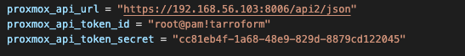
TRANSFORM !!!
cred-auto.tfvars

Slide 20
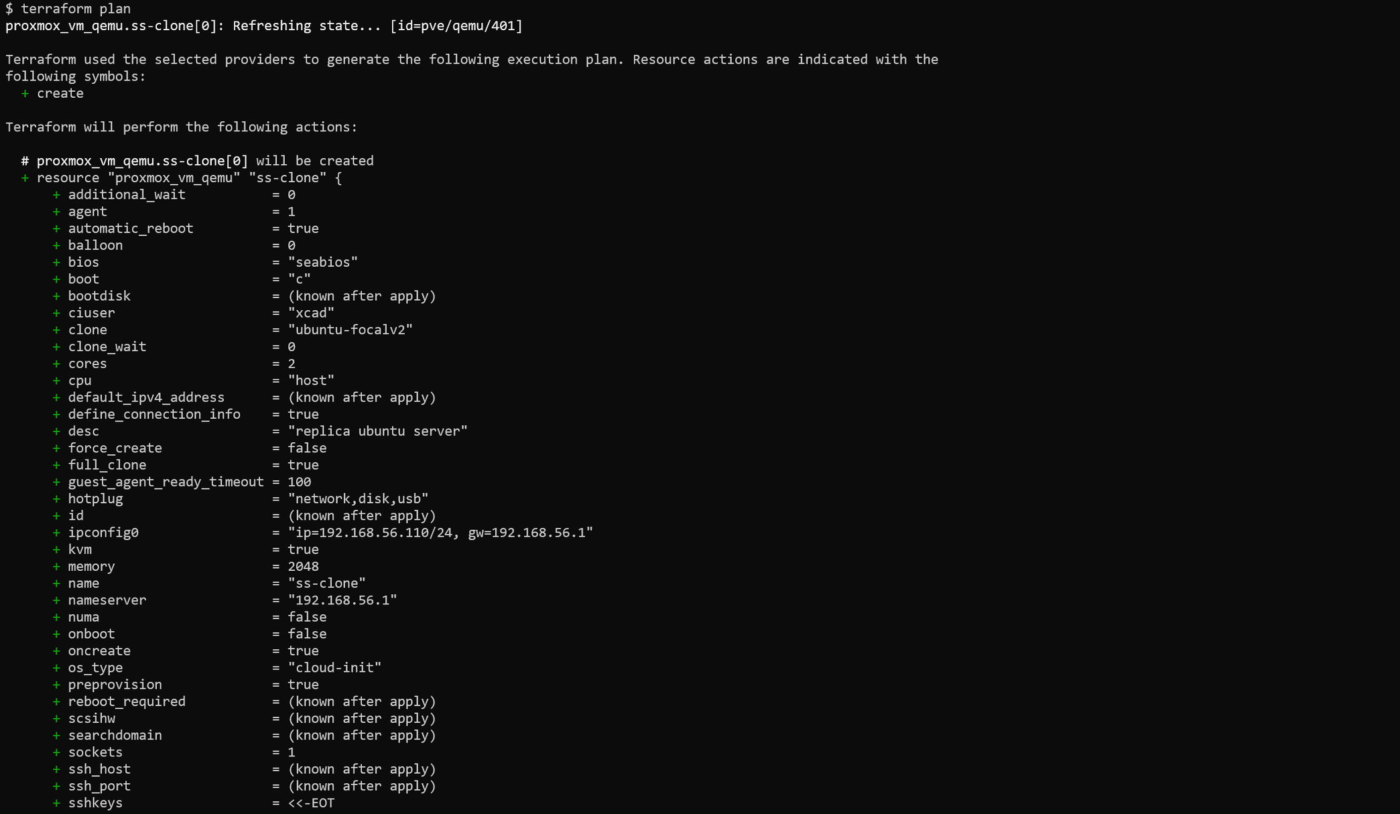
TRANSFORM !!!
$ terraform plan

Slide 21
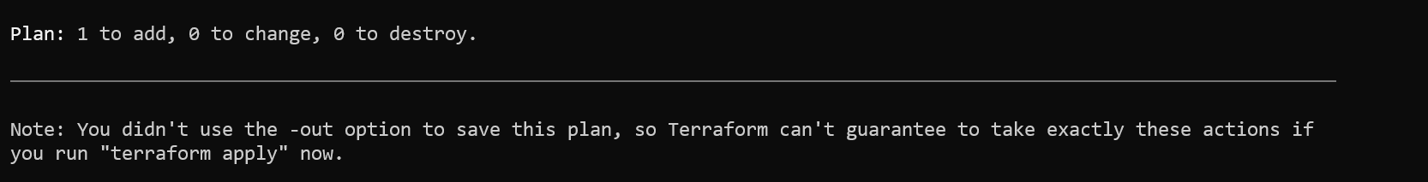
TRANSFORM !!!

Slide 22
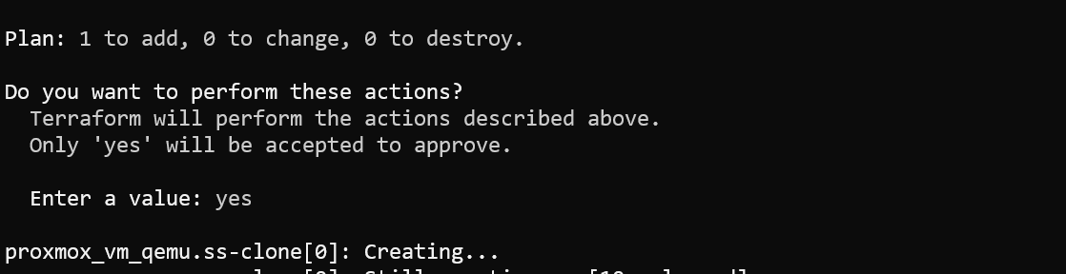
TRANSFORM !!!
$ terraform Apply

Slide 23
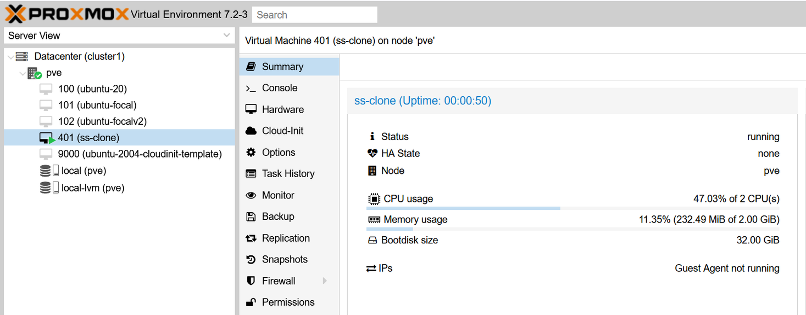

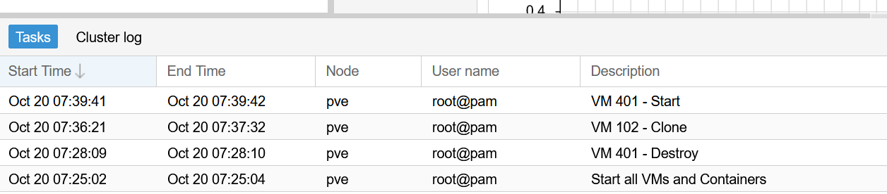
TRANSFORM !!!

Slide 24

Q & A

Slide 25

Git Repository
(slides, & sample scripts)
https://github.com/harimau99/DevOps-Diary/tree/master/talk-stories/JOMLAUNCH-2022

Slide 26






+(322)19295664699
me@najoe.info
@its.najoe
@harimau99
@najoetalks
CALL ME!

